Slide 1
V10 Configuration
Configuring Services

Slide 2
Assessment Creation process
Objective
At the end of this session you will be able to :
Configuring Services
Activate and configure straight-through invoice processing

Slide 3
Services and Service Requests

Slide 4
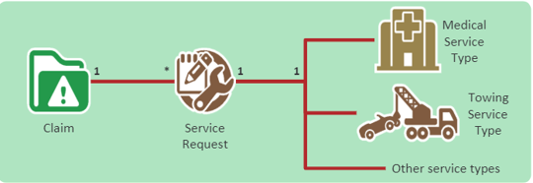
Services and Service Requests
A Service is any action that can be requested from a third-party vendor or internal provider
Examples included medical services, towing, auto rental, construction services for fire restoration…
A service request summarizes the instruction sent to the vendor detailing the service to be performed
Every service request us associated with exactly one claim and one service type.
Notes:
A service is the work that needs to be done. A service request is the record of communications with vendor(request service, receive/approve quote, receive/pay invoice, etc)
Vendors are typically stored in an address book application ( such as Guidewire ContactManager) and retrieved when need for services

Slide 5
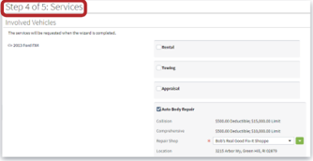
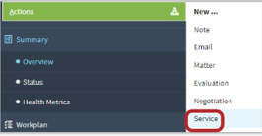
Creating Service Requests
Service requests can be created
During claim creation
Later, using the Action menu
Notes:
Adjusters may need to create services at the time of claim creation, but the specific services needed may not be know until some time after the claim is created.

Slide 6
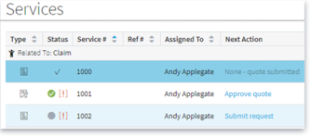
Service Request Types
The service request type determines the life cycle of the service request
Lifecycle is managed by a state handler specific to the service request type
In the base application, there are four service request types
Quote only
Quote and perform service
Service only
Unmanaged service
Implement through typelist
ServiceRequestKind
Notes:
Service request type is distinct from service type which is the kind of service being quoted or performed.
It is possible to create other service request types and their associated state handlers by extending ServiceRequestStateHandler.gs; but the details of doing this are outside the scope of this course.
Unmanaged services service requests are created only in the Auto First and Final wizard. The adjuster can proceed directly to add invoices and make payments once the wizard is complete

Slide 7
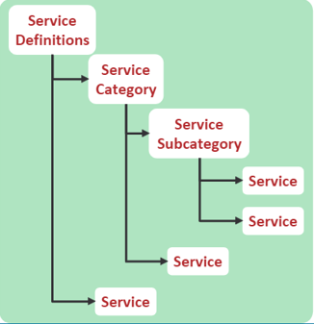
Service definitions (conceptual)
Services are defined in a tree-like hierarchy
The base configuration allows services to be placed in service categories or subcategories, or “stand-alone”
For integration with ContactManager use the same services definitions for both applications
Notes:
This is a conceptual view of now services are defined in the application. There are three possible “levels” of services, arranged in a hierarchy that allows services to be organized into categories and subcategories
The “tree” structure is defined in an xml files we shall see in a few slides
An example of the three levels
“Auto” (“svc.aut”) is a top level service definition
“Auto Inspection” (“svc:aut_ins”) is a second level service category
“Auto Inspect and repair audio” (“svc:aut_ins_aud”) is a third level subcategory
The three-level structure is somewhat arbitrary, and can be extended with a bit of work

Slide 8
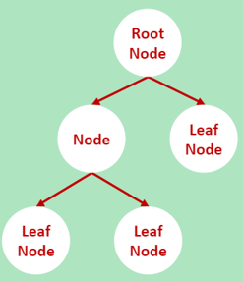
Vendor Service tree (conceptual)
Each service type must be defined in the file
Defines a hierarchy of services
Each service has zero or one parent services
A service with no parent called a root node
Each service has zero to many child services
A service with no child is called a leaf node
Notes:
As mentioned on the previous page, there are three levels of services arranged here as “nodes”
In the example from the previous page notes, “auto” is the root node and “auto inspect and repair audio” is a leaf node

Slide 9
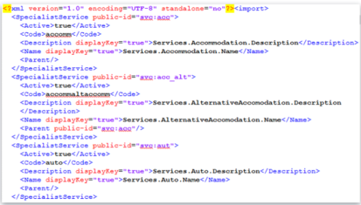
Venodorserivetree.xml
Each service has:
A public-id
A code
One or more descriptions
An optional parent
(Optional children are not defined in the parent node)
Notes:
The file vendorserivestree.xml defines the hierarchy of services for a ClaimCenter implementation.
This file is found at configuration→ config→ sampledata→vendorservicetree.xml
You can add levels to the hierarchy simply adding a fourth level of referentiality to the vendor service tree. However, this will also require significant configuration of the UI, as there is no way in the base application to display a fourth level of services.
The screenshot shows two root nodes / service definitons (“svc:acc” for “accomadation” and “sc:aut” for “auto”) and one leaf node / service category (“svc:acc_alt”, a child of “svc:acc” for “alternative accomadtion”
This file is also present Guidewire ContactManager enabling easy search for a particular service provider type

Slide 10
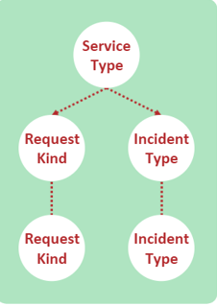
Service details (conceptual)
Services are linked to service request types using the file venodorservicedetails.xml, which lists specialist service types
Each SpecialistService with no child must at least one linked ServiceRequestKind
Each SpecialistSerivce with no parent must have at least one linked IncidentType
SerivceRequestKinds are generally deinfed before IncidentTypes

Slide 11
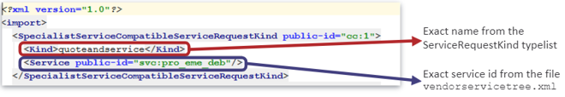
vendorserivcedetails.xml - request kinds
SpecialistServiceCompatibleServiceRequestKind defines handling of service requests
Notes:
venodorservicedetails.xml is basically a set of associations. Request kinds associate a request kind with a leaf node service ( a given service may be associated with more than one request kind)
The file is found at configuration → config → sampledata → vendorservicedetails.xml.
The base application includes four request kinds; quote only, quote and service, service only and unmanaged. Unmanaged is only available in the Auto First and Final wizard where it is mandatory.
The ServiceRequestKind typlelist is extensible

Slide 12

vendorservicedetails.xml – incident kinds
SpecialistServiceCompatibleIncidentKind defines incident subtypes applicable to a given service type
Notes:
vendorservicedetails.xml is basically a set of associations. Incident types associate an incident type with a root node service. ( A service may be associated with more than one incident type.
Incident types are subtypes of the incident class. In the base application, these included
Injury Incident
Property Incident
Fixed Property Incident
Dwelling Incident
Other Structure Incident
Living Expense Incident
Mobile Property Incident
Baggage Incident
Property Contents Incident
Vehicle Incident
Trip Incident

Slide 13
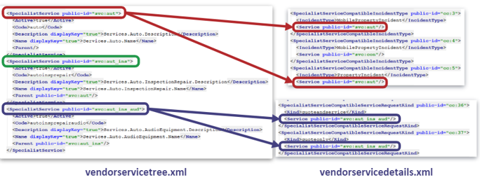
Linking the vendor service tree to the vendor service details
Notes:
Here is a set of examples of how the associations play out between the two files.
Auto (svc:aut) is a root node and must be associated with one or more Incident Type.
Auot – Inspection / Repair – Audio Equipment (svc:aut_ins_aud) is a leaf node and must be associated with one or more Service Request kind
Auto – Inspection / Repair (svc:aut_ins) is neither a leaf node nor root node and is not associated with the vendor service at all.

Slide 14
Two Important notes
When you finished editing and importing vendorservicetree.xml and vendorservicedetails.xml, you must restart ClaimCenter ( and ContactManager in the case of vendorservicetree.xml) for the changes take effect
If you add child node to a node whose service type has previously been assigned to any service providers, then importing vendorservicetree.xml will cause errots which must be corrected
Notes:
When you have finished editing the two vendor service files, you must import them using Administration pages ( Administration → Utilities → Import Data) then restart the ClaimCenter server.
If you are using ContactManager and edit vendorservicetree.xml, you must do the same there.
A node which is not a child node cannot be associated with a service request kind nor with a service provider. Therefore, if you attempt to import a service tree that adds a child to a node that has these associations, an error will occur

Slide 15
Configuring Services

Slide 16
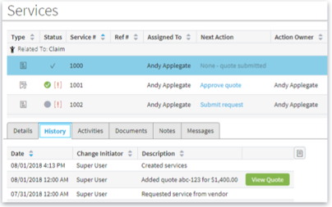
Service Request History
Changes to a service request are recorded and displayed on the History tab of the Services screen
Notes:
History event records can be associated with a service request. Major events in the life cycle of a service request are listed on the History tab of the Services screen
The history event records may include links to documents such as quotes and invoices

Slide 17
Creating service request history
Service request history is created using the ServiceRequest.recodChange () method
Returns a ServiceRequestChange object, which provides the history record, with fields populated to indicate the changes made
Notes:
If you need to configure the creation of service request history records, use the recordChange() method of Service Request as shown in the slide

Slide 18
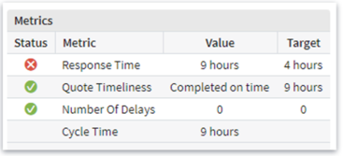
Service request metrics in the base application
ClaimCenter 10 provide six measurements on the status and timeliness of service request in the Metrics section of the Service screen
Only the Metrics relevant to a given service request displayed
Notes:
Each service request has a set of associated metrics which are calculated whenever the Details tab for that service request is displayed. Only those metrics are displayed which are relevant to the current service request; thus a “service only” service request will not have the metrics involving quotes.

Slide 19
Adding service request metrics
Create a subtype for the new metric
Add the new metric to the implementation class
Test the changes
For full details, see the Guidewire ClaimCenter Configuration Guide
Notes:
The details of extending service request metrics are beyond the scope of this lesson; however, these details can be found in the ClaimCenter Configuration Guide

Slide 20
Review Question
When and Where can service requests be created?
During claim creation, in the New Claim Wizard
After the claim has been created, from the Action menu

Slide 21
Review Question
What are the types of Service Request in the base application?
Quote Only
Service Only
Quote and Perform Service
Unmanaged Service ( for Auto First and Final only)

Slide 22
Review Question
If you need to add a new service type, what files must you modify?
vendorservicetree.xml
vendorservicedetails.xml

Slide 23
Review Question
After modifying the files, what must you do for the new service type to be available ?
Import the data from the files in the ClaimCenter (and ContatManager) administrator user interface(s)

Slide 24
Adding Services

Slide 25
Configuring Straight-Through Invoice Processing (STIP)

Slide 26
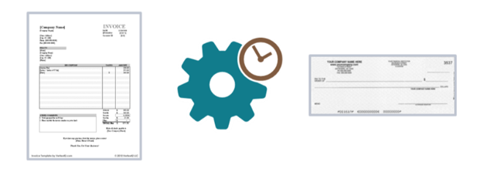
Straight-through invoice processing (STIP)
Automates the approval and payment of many routine invoices.
Payments can be made against Reserve Lines, at either the Claim or the Exposures level
Notes:
Straight-through invoice processing (STIP) allows the approval and payment of routine invoices without human intervention
For example, if an insurer regularly does business with a particular glass repair firm. It may be advantageous to automatically approve and pay their invoices for windshield replacement because manual payment takes time and costs money.
This is a highly configurable behavior of ClaimCenter, allowing you to determine which invoices are to be automatically approved and paid, and under what circumstances.

Slide 27
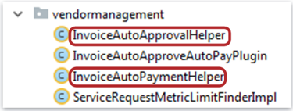
Helper Classes
STIP is implemented using State Transition Helper classes
Two helper classes in the base application:
InvoiceAutoApprovalHelper manages automatic approvals
InvoiceAutoPayamentHelper manages automatic payments
To change the criteria for automatic processing, change the implementation of the helper classes,
Notes:
The two helper classes which enable STIP are the InvoiceAutoApprovalHelper and the InvoiceAutoPayamentHelper, which respectively determine whether an invoice can be automatically approved, and whether it can be automatically paid. Changing the implementation of these helpers changes the behavior of STIP accordingly.

Slide 28
Helper methods
Each helper has four required methods:
getRelevantInvoices () returns a list of invoices to be processed.
In the base application, returns invoice waiting to be approved or paid
For each invoice returned by getRelevantInvoices, getFailedToQualifyReasons() returns a list of reasons why the invoice cannot be processed.
performAction() – if getFailedToQualifyReasons() returns an empty list, processes the invoice
InvoiceAutoApprovalHelper marks the invoices as approved
InvoiceAutoPaymentHelper creates a check and marks the invoices as paid.
registerFailuer() – if the list of reasons is not empty, creates ( or updates) an activity to manually process the invoice
Activity patterns in the base application are INVOICE_NOT_AUTO_APPROVED and INVOICE_NOT_AUTO_PAID
Activity includes the list of reasons not processed
Notes:
There are four configurable methods in each helper:
getRelevantInvoices() finds invoices which are current candidates for automatic approval and payment, and returns a list of those invoices.
getFailedToQualifyReasons() looks at each invoice in the list, searches for reasons why each invoice should not be processed automatically, and returns a list of those reasons for each invoice.
If the list produced by getFailedToQualifyReasons() for a given invoice is empty then performAction() completes the automated processing of that invoice. Depending on which helper is currently active, this might be approval or payment.
If the list produced by getFailedToQualifyReasons() for a given invoice is not empty, the registerFailure() instruct the appropriate user, via an activity, to manually process the invoice. The activity lists the reasons uncovered by getFailedToQualifyReasons()

Slide 29
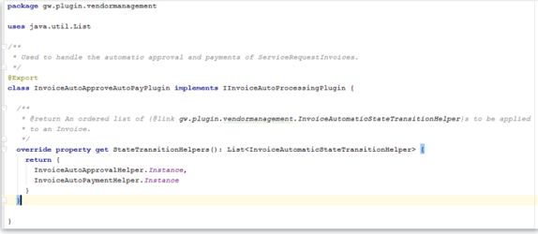
Plugin
The helpers are instantiated by a plugin
The plugin provided in the base configuration is the InvoiceAutoApproveAutoPayPlugin
Notes:
The InvoiceAutoApproveAutoPayPlugin has one method which returns instances of the two helpers.
The plugin is registered in the plugin registry using
IInvoiceAutoProcessingPlugin

Slide 30
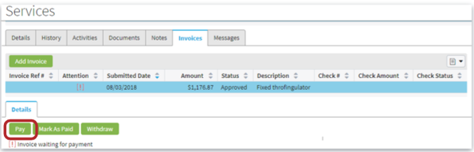
STIP in the UI
On the Invoices tab, when the user clicks the button to pay an invoice which was not previously approved, ClaimCenter invokes the invoice automatic processer
Notes:
If STIP automatically pays the invoice then the user is forwarded to the check details page for the check produced.
If STIP cannot pay the invoice, then the Check Wizard begins as usual.

Slide 31
Processor
When invoices enter the system, either manually or through an integration, a “processor” is invoked
This occurs after any regular Gosu rules are run on the invoice
Runs independently of the bundle which creates the invoice
Any prior work by the user is not affected
In the provided implementation, the processor uses each helper as a “checklist”
Each of a series of potential failure reasons is checked against each invoice associated with the service request.
If none of the failure reasons match the invoice, the action, such as approval or payment, is automatically performed.
Notes:
If at lease one failure reason matches the invoice, then every reason that matches adds a descriptive string (such as “the amount is too high”) to a list of string called failureReasons. This list is returned to the Service Request with which the invoice is associated as Activity, using the patterns invoice_not_auto_approved and invoice_not_auto_paid

Slide 32
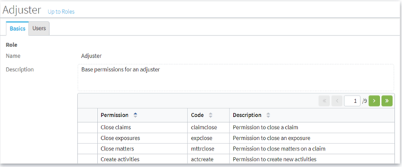
Permissions
The permissions and authority limits of the users who inputs an invoice are used in determining whether the invoice can be automatically approved and paid
Notes:
Invoices that enter ClaimCenter directly from a vendor’s system through an integration do so by means of a Web service. Web services required some user’s authority to run. In this case, that user’s permissions and authority limits are used in determining whether the invoice can be automatically approved and paid

Slide 33
Possible configurations to STIP
Turing STIP off
STIP is turned on by default in the base configuration
Changing criteria for automatic processing of invoices
Changing criteria for which invoices may be automatically processed.
Changing what kinds of processing are automated
Notes:
There are four basic configurations that can be performed for STIP. We will look at each of these configuration in details

Slide 34
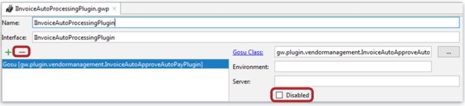
Turning STIP off
STIP is implemented using the IinvoiceAutoProcessingPlugin
In the base application, this is implemented using InvoiceAutoApproveAutoPayPlugin
To turn STIP off, deregister or disable the plugin
Notes:
The simplest configuration is to STIP off completely. To do this, deregister or disable the implementation of IinvoiceAutoProcessingPlugin

Slide 35
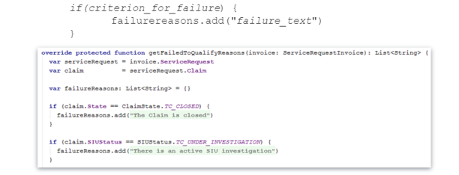
Changing criteria for automatic processing of invoices
To Change the criteria for which invoices will be automatically approved or paid, edit the getFailedToQualifyReasons() method of relevant helper
Add, edit, or delete clauses of the form
Notes:
You can add, delete, modify, or comment out the reasons for an invoice to fail-to-qualify for STIP processing by editing the getFailedToQualifyReasons() method of one or both helpers. This will be most common configuration of STIP

Slide 36

Changing the maximum amount that can be auto-approved
InvoiceAutoApprovalHelper has property that maps currencies to the largest amount that can be automatically approved
The last “if” clause of getFailedToQualifyReasons in InvoiceAutoAprrovalHelper rejects invoices that exceed this amount
To change the maximum amount that can be auto-approved, modify the SmallAmountThresholds property
Notes:
You can change the maximum amount that can be automatically approved by editing the SmallAmountThresholds property of the InvoiceAutoApprovalHelper

Slide 37
Changing criteria for which invoices can be automatically processed
To change which invoices are considered for automatic approval or payment, modify the gerRelevantInvoices() method of the relevant helper
The method must return List<ServiceRequestInvoice> to be consumed by the getFailedToQualifyReasons method
Notes:
In the base application, gerRelevantInvoices() simply returns list of all invoices where “isWaitingForApproval” is true. To change this behavior, edit the logic of the gerRelevantInvoices() method. Be sure that it returns a list of ServiceRequestInvoice objects to be checked for failure to qualify reasons

Slide 38
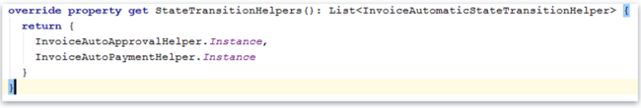
Changing the kinds of processing that are automated
To change the kinds of processing automated by STIP, edit the StateTransitionHelpers property of InvoiceAutoApproveAutoPayPlugin
Comment out one of the existing helpers
Create and add your own helper
Note : Do this with extreme caution
Notes:
If, for example, you want STIP to approve but not pay invoices, comment out the relevant helper. It is not recommended to remove the helper completely.
You can also create new helpers. Be very careful doing this, as it may result in unexpected application behavior.

Slide 39
Review Question
What do State Transition Helper classes enable?
Straight-Through Invoice Processing (STIP)
Notes:
If, for example, you want STIP to approve but not pay invoices, comment out the relevant helper. It is not recommended to remove the helper completely.
You can also create new helpers. Be very careful doing this, as it may result in unexpected application behavior.

Slide 40
Review Question
If an invoice comes into the system through a vendor portal, what provides approval limits for STIP?
The web service that accepts the invoice is associated with a user, whose permissions enable that web service.
The approval limit are those of that user.
Notes:
If, for example, you want STIP to approve but not pay invoices, comment out the relevant helper. It is not recommended to remove the helper completely.
You can also create new helpers. Be very careful doing this, as it may result in unexpected application behavior.

Slide 41
Review Question
What do State Transition Helper classes enable?
Straight-Through Invoice Processing (STIP)
Notes:
If, for example, you want STIP to approve but not pay invoices, comment out the relevant helper. It is not recommended to remove the helper completely.
You can also create new helpers. Be very careful doing this, as it may result in unexpected application behavior.

Slide 42
Review Question
What do State Transition Helper classes enable?
Straight-Through Invoice Processing (STIP)
Notes:
If, for example, you want STIP to approve but not pay invoices, comment out the relevant helper. It is not recommended to remove the helper completely.
You can also create new helpers. Be very careful doing this, as it may result in unexpected application behavior.

Slide 43
Thank you

